Slide 1
Week 13b
COMPUTATIONAL MATHEMATICS
2D Optimization Method – Direct Method
Friday, 5 June 2020

Slide 2
Reference
Kisualaas, Jann. (2013). Numerical Methods in Engineering with Python 3. Cambridge University Press.
Johansson, Robert. (2015). Chapter 5. Equation Solving. Numerical Python: A Practical Techniques Approach for Industry, Apress.
Chapra, S. C., and Raymond P. Canale. (2010). Numerical methods for engineers, Sixth edition, McGraw Hill.
Kaw, A. (n.d.). Numerical Methods. Retrieved March 20, 2020, from https://nm.mathforcollege.com/

Slide 3
Optimization Methods
One-Dimensional Unconstrained Optimization
Golden-Section Search
Quadratic Interpolation
Newton's Method
Multi-Dimensional Unconstrained Optimization
Non-gradient or direct methods
Gradient methods
Linear Programming (Constrained)
Graphical Solution
Simplex Method

Slide 4
Multidimensional Unconstrained Optimization
Techniques to find minimum and maximum of
f(x₁, x₂, ₃,…, x_{n})
2 classes of techniques:
Do not require derivative evaluation
Non-gradient or direct methods
Require derivative evaluation
Gradient or descent (or ascent) methods

Slide 5
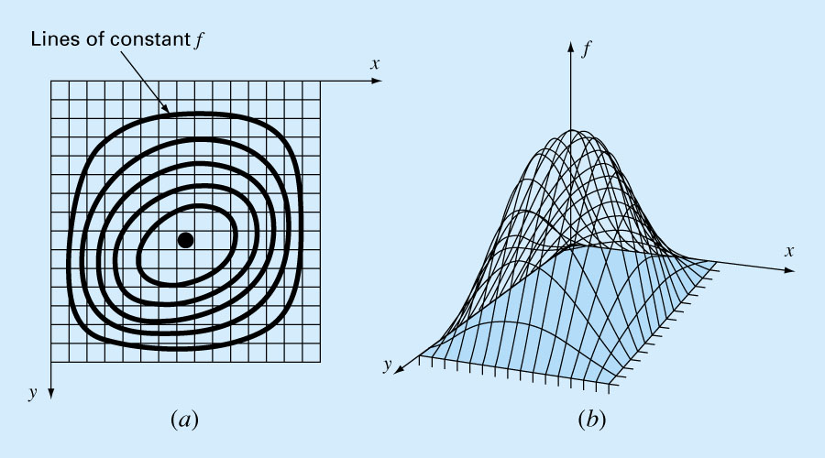
2-D Contour View of f(x, y)

Slide 6
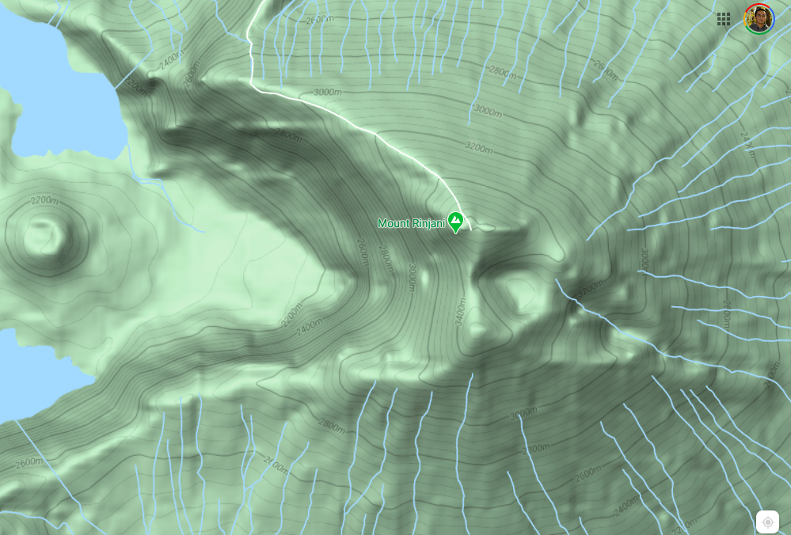
Real Example: Mt. Rinjani

Slide 7
DIRECT METHODS — Random Search
max = -∞
for i = 1 to N
for each x_{i}
x_{i} = a value randomly selected from a given interval
if max < f(x₁, x₂, ₃,…, x_{n})
max = f(x₁, x₂, ₃,…, x_{n})
N has to be sufficiently large
Random numbers have to be evenly distributed.

Slide 8
Random Search
Advantages
Works even for discontinuous and nondifferentiable functions.
Always finds the global optimum rather than the global minimum.
Disadvantages
As the number of independent variables grows, the task can become onerous.
Not efficient, it does not account for the behavior of underlying function.

Slide 9
Finding the Optimum Systematically
Basic Idea (Like climbing a mountain)
If we keep moving upward, we will eventually reach the peak.
Which path should you take?
Question
If we start from an arbitrary point, how should we "move" so that we can locate the peak in the shortest amount of time?
Good guess of direction toward the peak
Minimize computation
?
You are here. Peak is covered by the cloud.

Slide 10
General Optimization Algorithm
All the methods discussed subsequently are iterative methods that can be generalized as:
Start at x_{o} = { x₁, x₂, …, x_{n} }
Repeat
Select a direction S_{i}
x_{i+1} = Optimal point reached by traveling from x_{i}
in the direction of S_{i}
Until (|(f(x_{i+1}) – f(x_{i})) / f(x_{i+1})| < e_{s1} or
|| x_{i+1} – x_{i}||/||x_{i+1}|| < e_{s2})

Slide 11
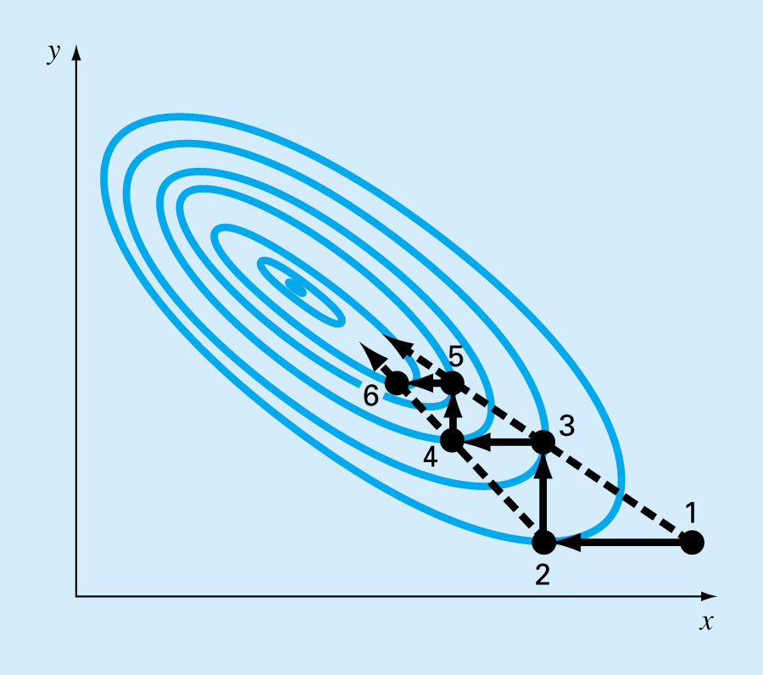
Univariate Search
Idea: Travel in alternating directions that are parallel to the coordinate axes. In each direction, we travel until we reach the peak along that direction and then select a new direction.

Slide 12
Univariate Search
More efficient than random search and still doesn’t require derivative evaluation.
The basic strategy is:
Change one variable at a time while the other variables are held constant.
Thus problem is reduced to a sequence of one-dimensional searches
The search becomes less efficient as you approach the maximum. (Why?)

Slide 13
Univariate Search – Example
f(x, y) = y – x – 2x² – 2xy – y²
Step 1: set x = 0 (pick a value as starting point)
Want to maximize f(0, y) = y – y²
Solving f' = 0 => 1 – 2y = 0 => y_{max} = 0.5
Step 2: set y = 0.5
Want to maximize f(x, 0.5) = 0.5 – x – 2x² – x – 0.25
Solving f' = 0 => -1 – 4x – 1 = 0 => x_{max} = -0.5
Step 3: set x = -0.5
Want to maximize f(-0.5, y) = y + 0.5 – 0.5 + y - y²
Solving f' = 0 => 1 + 1 – 2y = 0 => y_{max} = 1
…
Repeat until x_{i+1} = x_{i} or y_{i+1} = y_{i} or e_{a} < e_{s}.

Slide 14
Pattern Search Methods
Observation: Lines connecting alternating points (1:3, 2:4, 3:5, etc.) give better indication where the peak is (as compared to the lines parallel to the coordinate axes).
The general directions that point toward the optima is also known as the pattern directions.
Optimization methods that utilize the pattern directions to improve convergent rate are known as pattern search methods.

Slide 15
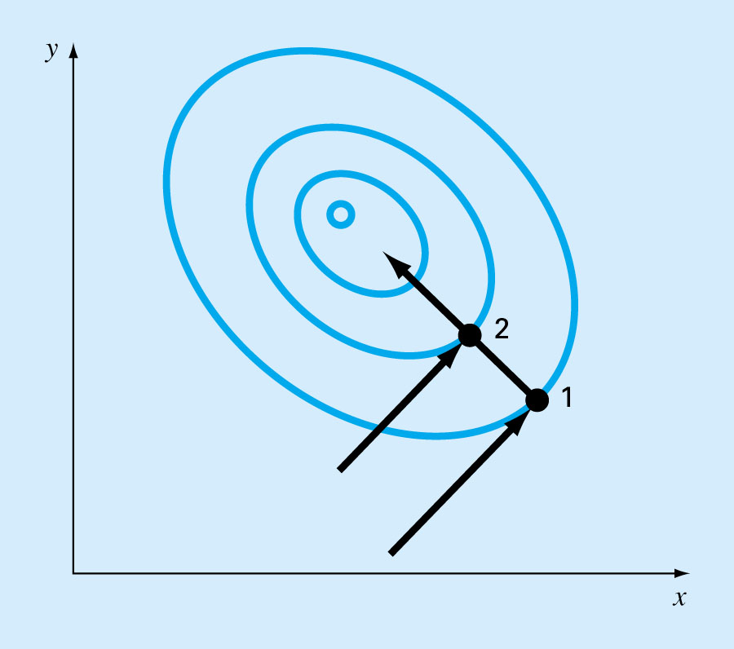
Powell's Method
Powell’s method (a well-known pattern search methods) is based on the observation that if points 1 and 2 are obtained by one-dimensional searches in the same direction but from different starting points, then, the line formed by 1 and 2 will be directed toward the maximum. The directions represented by such lines are called conjugate directions.

Slide 16
Start at point 0, and pre-select 2 initial directions S1 and S2. Let's S1 be parallel to y-axis and S2 be parallel to X-axis.
(Each direction will only be used twice)
0

Slide 17
Move from point 0 in direction S1 to point 1.
Move from point 1 in direction S2 to point 2.
(Each direction has been traversed once so far.)
1
S2
2
S1
0

Slide 18
Move from point 2 in direction S1 to point 3.
S3 = conjugate direction formed by point 1 and point 3
Drop S1 (as it has been traverse twice) but add S3.
S3
3
1
S2
2
S1
0

Slide 19
Move from point 3 in direction S3 to point 4. (We want to move in conjugate direction whenever it becomes available).
S3
3
4
1
S2
2
0

Slide 20
Move from point 4 in direction S2 to point 5 (we already moved in direction S3 in previous step).
S4 = conjugate direction formed by point 2 and point 5
Drop S2 (as it has been used two times) but add S4.
S3
5
3
4
1
2
S4
0

Slide 21
Move from point 5 in direction S4 to point 6.
S3
6
5
3
4
1
2
S4
0

Slide 22
Move from point 6 in direction S3 to point 7.
S5 = conjugate direction formed by point 4 and point 7
Drop S3 (as it has been used two times) but add S5.
The process continue until it converges
7
6
5
3
4
1
2
S5
S4
0

Slide 23
Quadratically Convergent
Definition: If an optimization method, using exact arithmetic, can find the optima point in n steps while optimizing a quadratic function in n variables, the method is called a quadratically convergent method.
If f(x) is a quadratic function, sequential search along conjugate directions will converge quadratically. That is, in a finite number of steps regardless of the starting points.

Slide 24
Conjugate-based Methods
Since general non-linear functions can often be reasonably approximated by a quadratic function, methods based on conjugate directions are usually quite efficient and are in fact quadratically convergent as they approach the optimum.

Slide 25
Summary
Random Search
General algorithm for locating optimum point
Guess direction
Find maximum point in the guessed direction
Univariate Search
Conjugate direction
Powell's Method

